Slide 1
Technical overview of single-cell transcriptomics methods.
1. General considerations / experimental settings.
2. scRNA-seq plates-based methods: template-switch versus T7.
3. Droplet-based scRNA-seq.
4. Combinatorial indexing approaches for scRNA-seq
5. Other –omics approaches.
6. Integrated multi-omics approaches.
Sébastien Smallwood – FMI
sebastien.smallwood@fmi.ch
SIB / SciLifeLab - Single-cell RNA-Seq Analysis (Leysin 2019)

Slide 2
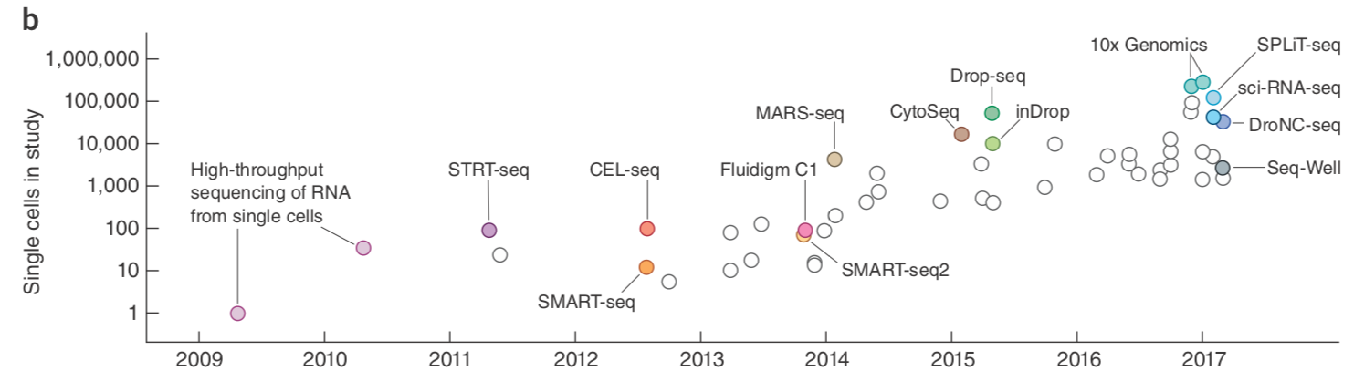
Technical overview of single-cell transcriptomics methods.
Svensson et al. Nat Protocols, 2018
Sébastien Smallwood – FMI
sebastien.smallwood@fmi.ch
SIB - Single-cell RNA-Seq Analysis (Leysin 2019)

Slide 3
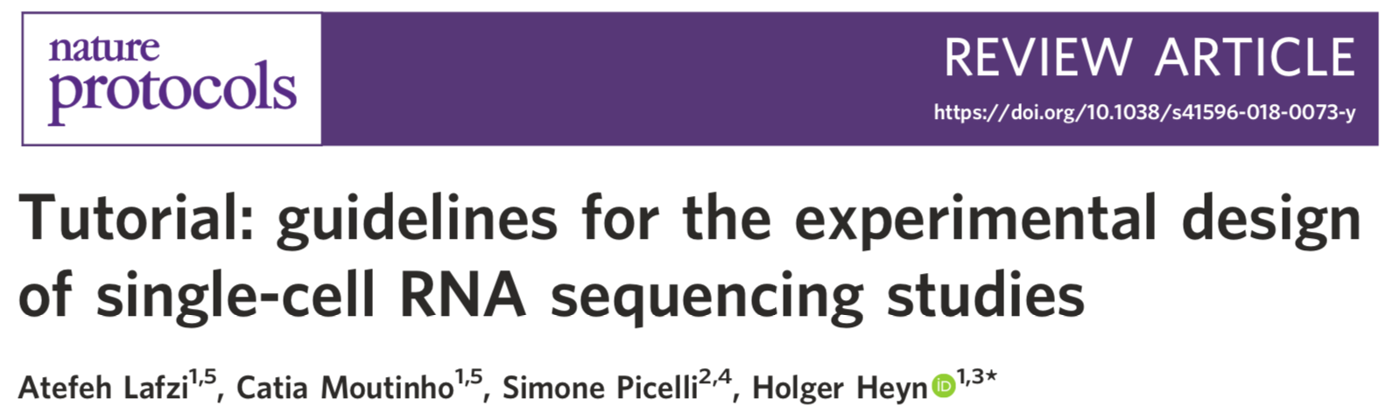
How to select the right protocol for a given biological question?
How many cells do I need to sequence?
Are my cells precious or can collection repeated easily?
How can I collect cells? How many cells can I collect in one experiment?
Available equipment / Cost considerations...
Plate-based approaches are still relevant in 2019.
Replicates are still needed.
Collecting healthy single cells is CRITICAL and can be challenging. Optimisations are required.
In 2019, success of scRNA-seq is more dependent on cells than actual protocol
Many methods, many “copies”
Common / specific issues…little extensive comparisons…
Differences between labs and projects / cell types: same method -> different quality datasets

Slide 4
Some scRNA methods
F.Tang 2009
Template-Switch Based
PCR amplification of “full length” cDNA
T7-based
Linear amplification of cDNA
STRT-seq
SmartSeq
CEL-seq
CEL-seq2
MARS-seq
BAT-seq
SmartSeq2
SCRB-seq
InDrop
sNuc-Seq
Div-Seq
Drop-Seq
10x
DroNc-Seq
Combinatorial indexing
Nanowells
sci-RNA-seq
STRT-seq-2i
Seq-Well
Microwell-seq
SPLiT-seq

Slide 5
General considerations on starting material, plate vs droplets
Plate format
FACS (cells + nuclei) directly in lysis buffer.
Accurate (96+384 plates), if good prep low doublets assumed.
Enrich for specific populations with known markers.
Mouth pipetting under microscope for very precious samples (e.g. early embryos).
Accurate, even if doublets can be hard to discard.
Low throughput + time consuming + skills.
Combination with Patch-clamp for neurons.
Laser Capture Microdissection.
Plates with isolated single cells can be stored at -80C in lysis buffer.
Droplet-based
Cells / Nuclei are encapsulated in oil droplets using microfluidics devices.
Capture rate: Drop-seq: low | InDrop: very high with optimisations | 10x ~50%
Doublets rate can be relatively high: 1-5%.
can be used with fixed cells (although lack of all-rounder protocol)
Accurate and reproducible cell count.
Procedure between SC isolation and lysis is longer than plate format. Cell death +++

Slide 6
Template-Switch Based
PCR amplification of “full length” cDNA
T7-based
Linear amplification of cDNA
STRT-seq
SmartSeq
MARS-seq
CEL-seq
CEL-seq2
SmartSeq2
SCRB-seq
MATQ-seq
InDrop
sNuc-Seq
Div-Seq
Drop-Seq
10x
DroNc-Seq
Combinatorial indexing
Nanowells
sci-RNA-seq
Seq-Well
SPLiT-seq
STRT-seq-2i

Slide 7
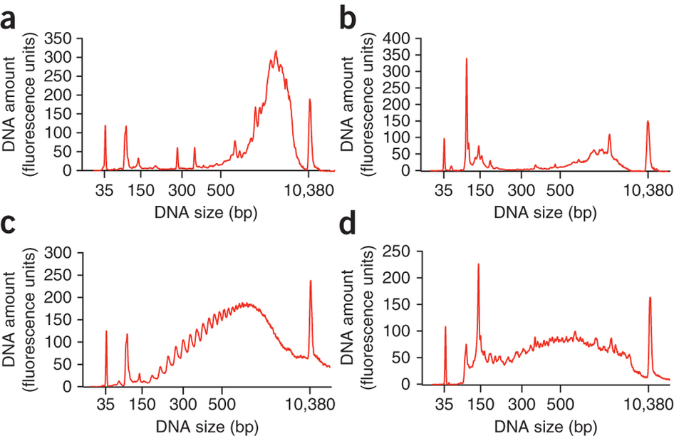
Template-Switch Based approaches with plate format: SmartSeq2
Cell Lysis and Poly-A capture
AAAAAAAA
TTTTTTTT-(PCR)
RT + Template-Switch
Single tube
(PCR)-GGG
AAAAAAAA
(PCR)-
CCC
TTTTTTTT-(PCR)
PCR preamplification using (PCR)
18-22cycles depending on cell type
(PCR)-GGG
AAAAAAAA-(PCR)
(PCR)-CCC
TTTTTTTT-(PCR)
Purification
“intact” mRNA
degraded mRNA
Picelli et al. Nat. Methods 2013

Slide 8
Template-Switch Based approaches with plate format: SmartSeq2
Cell Lysis and Poly-A capture
AAAAAAAA
TTTTTTTT-(PCR)
RT + Template-Switch
Single tube
(PCR)-GGG
AAAAAAAA-(PCR)
(PCR)-
CCC
TTTTTTTT-(PCR)
PCR preamplification using (PCR)
18-22cycles depending on cell type
(PCR)-GGG
AAAAAAAA-(PCR)
(PCR)-CCC
TTTTTTTT-(PCR)
Purification
Illumina library preparation using Tagmentation
Tn5
Tn5
Tn5
(PCR)-GGG
AAAAAAAA-(PCR)
(PCR)-CCC
TTTTTTTT-(PCR)
P5
P7
Picelli et al. Nat. Methods 2013
i5
i7

Slide 9
Template-Switch Based approaches: SmartSeq2 / STRT-Seq / SCRB-Seq
SmartSeq2
(PCR)-GGG
AAAAAAAA
CCC
TTTTTTTT-(PCR)
STRT-Seq
(PCR)—(UMIs)GGG
AAAAAAAA
CCC
TTTTTTTT-(PCR)
SCRB-Seq
(PCR)-GGG
AAAAAAAA
CCC
TTTTTTTT-(UMIs)-(BC)-(PCR)
SmartSeq2: full length / no UMIs / ~400+ cells per week
STRT-Seq: 5’ sequencing / UMIs / ~400+ cells per week
SCRB-Seq: 3’ sequencing / UMIs / ~3,000+ cells per week
Islam et al. Genome Research 2011 | Soumillon et al. bioRxiv 2014 | Bagnoli et al. Nat Commun. 2018

Slide 10
Template-Switch Based
PCR amplification of “full length” cDNA
T7-based
Linear amplification of cDNA
STRT-seq
SmartSeq
MARS-seq
CEL-seq
CEL-seq2
SmartSeq2
SCRB-seq
MATQ-seq
InDrop
sNuc-Seq
Div-Seq
Drop-Seq
10x
DroNc-Seq
Combinatorial indexing
Nanowells
sci-RNA-seq
Seq-Well
SPLiT-seq
STRT-seq-2i

Slide 11
T7 Based approaches – Plate format: CEL-Seq2
Cell 1
AAAAAAAA
AAAAAAAA
Cell 2
TTTTTTTT-BC1-UMI-P5-T7
RT
TTTTTTTT-BCn-UMI-P5-T7
AAAAAAAA
TTTTTTTT-BC2-UMI-P5-T7
Cell n
AAAAAAAA
2d strand synthesis
TTTTTTTT-BCn-UMI-P5-T7
AAAAAAAA-BCn-UMI-P5-T7
TTTTTTTT-BCn-UMI-P5-T7
Pool all cells
+ cDNA purification
P5
P7
T7 ivt - Linear amplification
UMI-BC
i7
PCR and indexing
BCn-UMI-P5
BCn-UMI-P5
P7-NNNNNN
BCn-UMI-P5
RNA purification
AAAAAAAA-BCn-UMI-P5-T7
BCn-UMI-P5
RT with
Integration of
Illumina “P7”
TTTTTTTT-BCn-UMI-P5-T7
Hashimshony et al. Genome Biology 2016

Slide 12
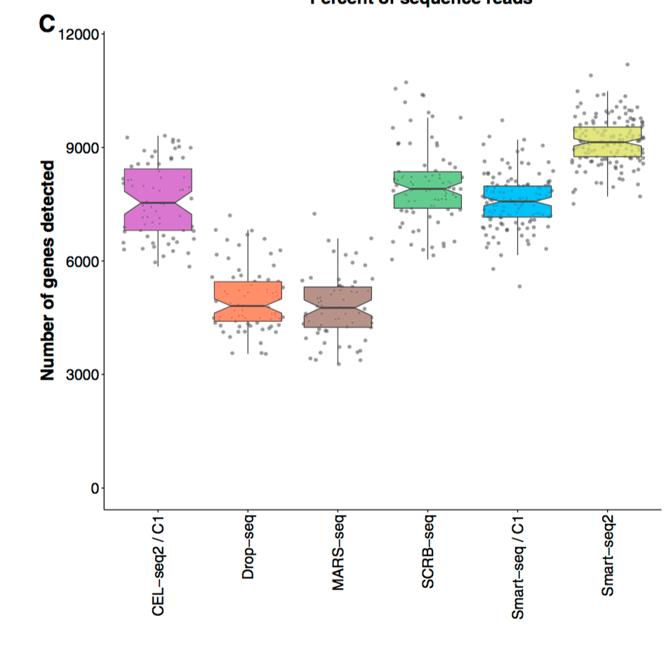
Pros & Cons of Template-Switch versus T7 – Plate format.
SMART-Seq2
Pros: Fast, easy and reliable. Single tube until preamp: safe for precious samples.
Cons: mRNA capture depends on poly-A capture and Template-switch efficiency.
cDNA PCR amplification -> bias (+ no UMIs for SmartSeq2)
CEL-Seq2
Pros: cDNA Linear Amplification. mRNA capture depends only on poly-A.
Cons: More complex protocol.
Pooling and purification of samples before amplification -> potential loss of material
-> higher throughput
-> Both approaches are valid. Key is mRNA capture and RT efficiency. Rest is less “crucial”
Ziegenhain et al.
Mol. Cell 2017

Slide 13


Pros & Cons of Template-Switch versus T7 – Plate format.
SMART-Seq2
Pros: Fast, easy and reliable. Single tube until preamp: safe for precious samples.
Cons: mRNA capture depends on poly-A capture and Template-switch efficiency.
cDNA PCR amplification -> bias (+ no UMIs for SmartSeq2)
CEL-Seq2
Pros: cDNA Linear Amplification. mRNA capture depends only on poly-A.
Cons: More complex protocol.
Pooling and purification of samples before amplification -> potential loss of material
-> higher throughput
Cost SmartSeq2: ~6-7CHF per cell with sequencing

Slide 14
Template-Switch Based
PCR amplification of “full length” cDNA
T7-based
Linear amplification of cDNA
STRT-seq
SmartSeq
MARS-seq
CEL-seq
CEL-seq2
C1
C1
SmartSeq2
SCRB-seq
MATQ-seq
InDrop
sNuc-Seq
Div-Seq
Drop-Seq
10x chromium
DroNc-Seq
Combinatorial indexing
Nanowells
sci-RNA-seq
Seq-Well
SPLiT-seq
STRT-seq-2i

Slide 15
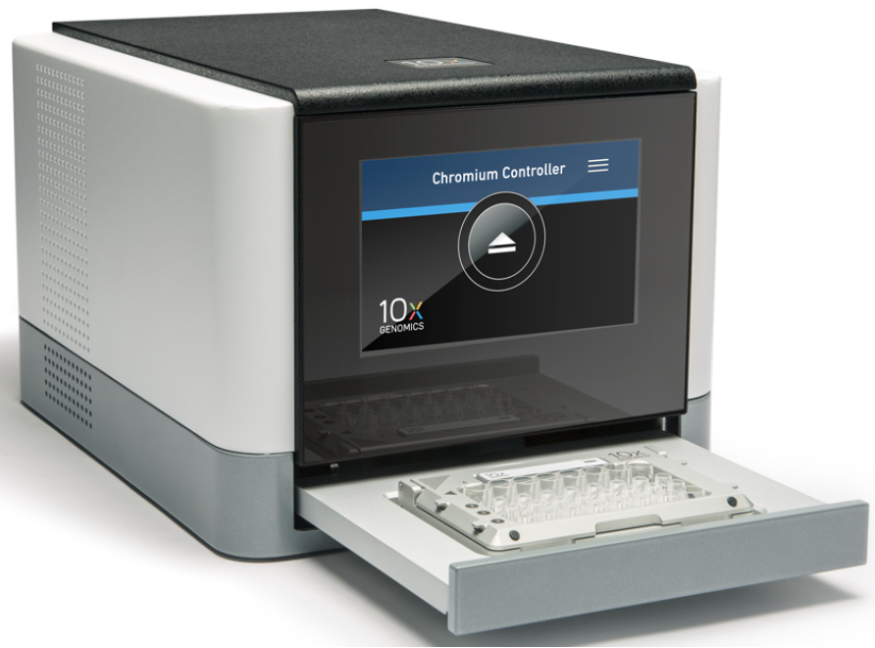
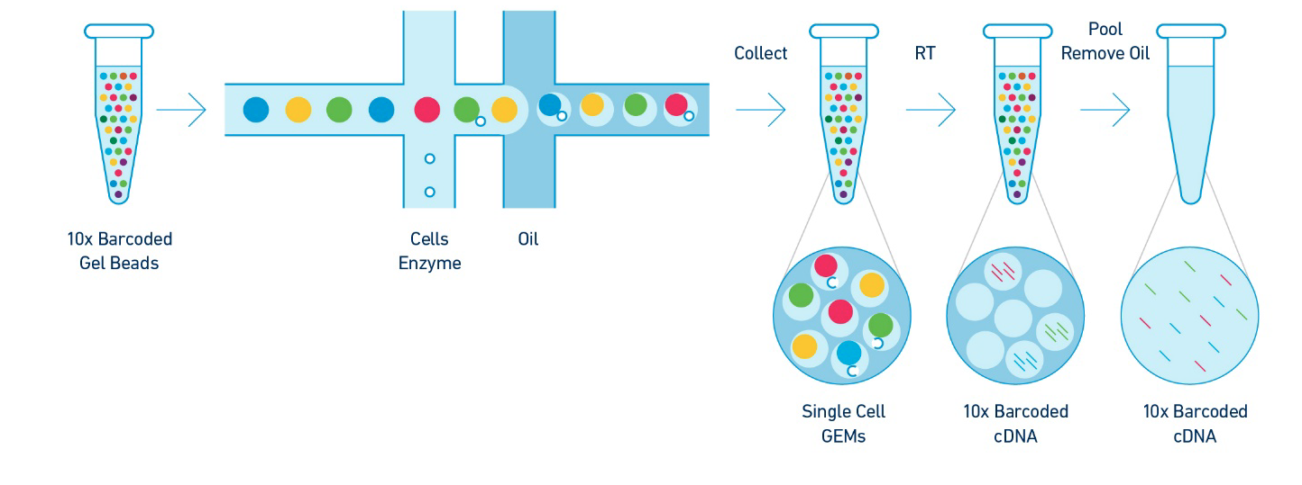
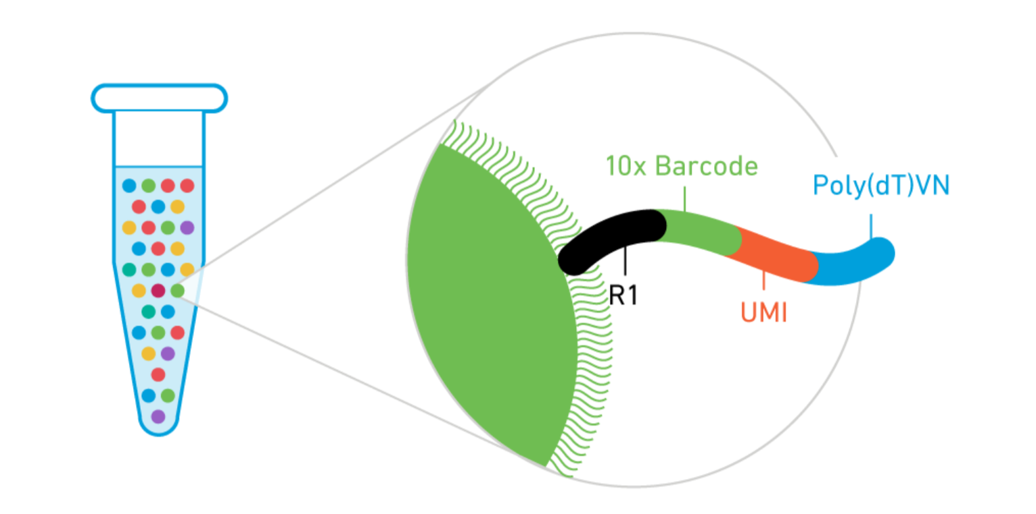
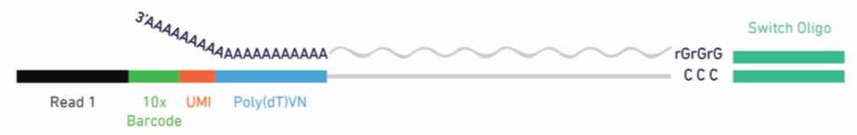
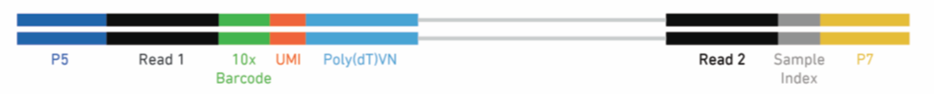
10x Chromium
Gel beads + RT in droplets + template-switch approach
cDNA amplification
and
library preparation
RT in beads
with template-switch
Full length cDNA amplification
Fragmentation and
Library preparation (3’)
Sequencing
R1: Barcodes + UMIs
R2: cDNA (3’ end)

Slide 16
10x Chromium
Gel beads + RT in droplets + template-switch approach
Pros: Ready-to-use box + kits.
Instrument “cheap”.
High quality data (although lower quality than SmartSeq2).
Good cell capture rate (~50%)
Reproducibility across labs / projects +++ (unlike Drop-seq / InDrop).
Very High Throughput. If money is not an issue: 150K+ cells in 2 days (without sequencing)
Cons: Not so convenient / cost effective for low cells numbers.
Cells have to be used fresh (although cell fixation is possible – cell type…).
Price per cell is low but experiments are very expensive…
Cell counting needs to be accurate and reproducible (new cell types can be challenging).
Doublets can be an issue.
Cost SmartSeq2: ~6-7CHF per cell with sequencing.
Cost 10x genomics: ~0.5-2CHF per cell with sequencing.
Plate / 10x cut-off is ~300cells with SmartSeq2 / ~600-800cells with SCRB-seq

Slide 17
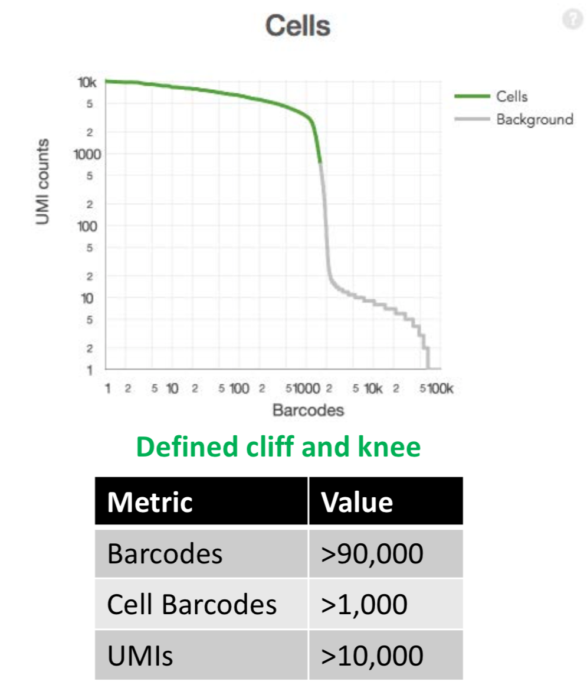
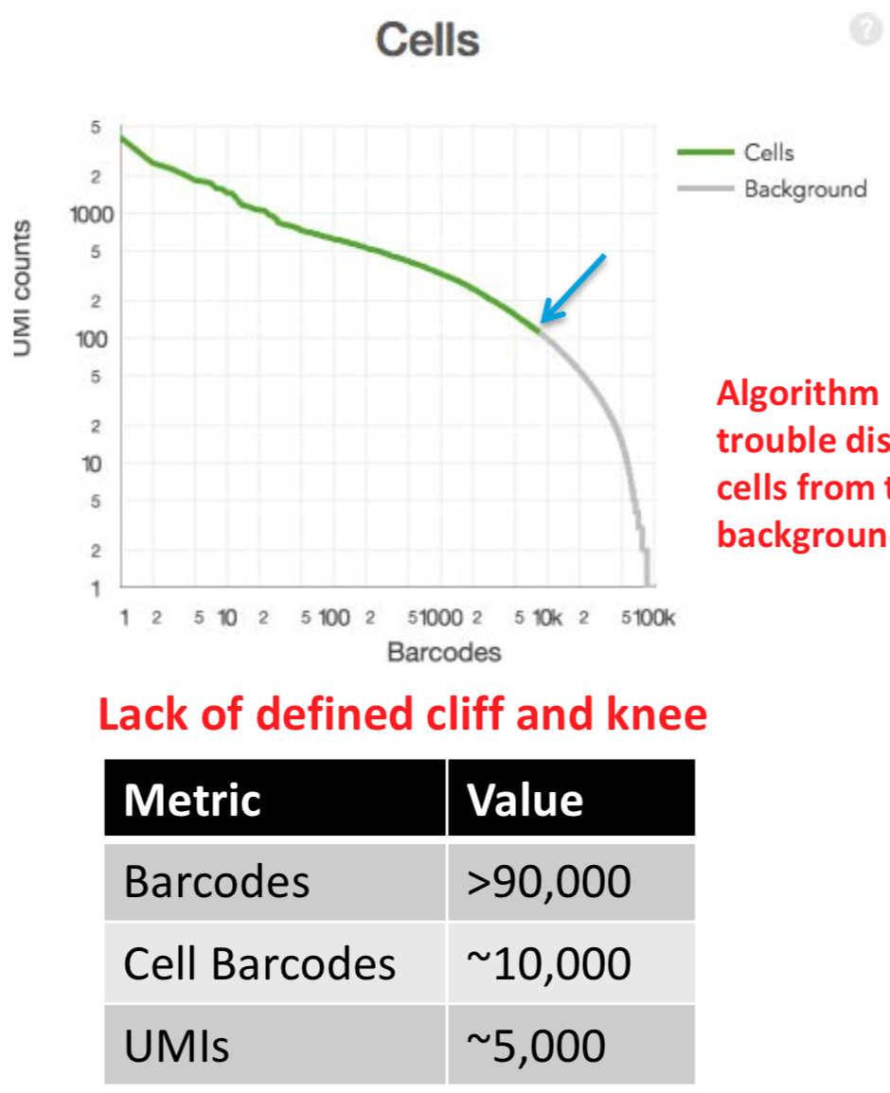
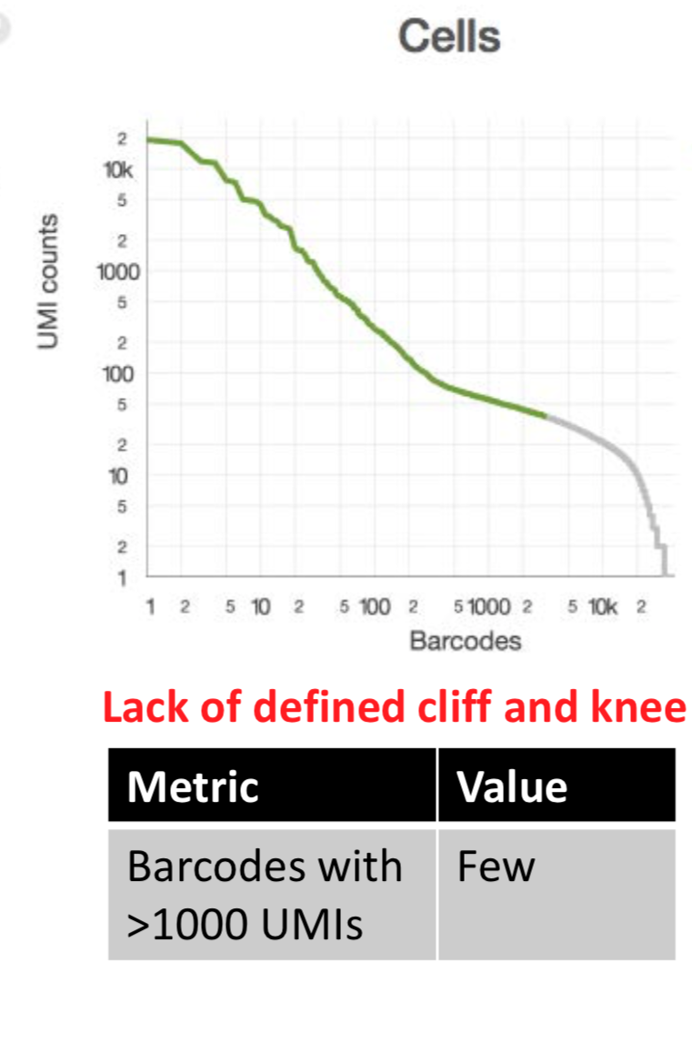
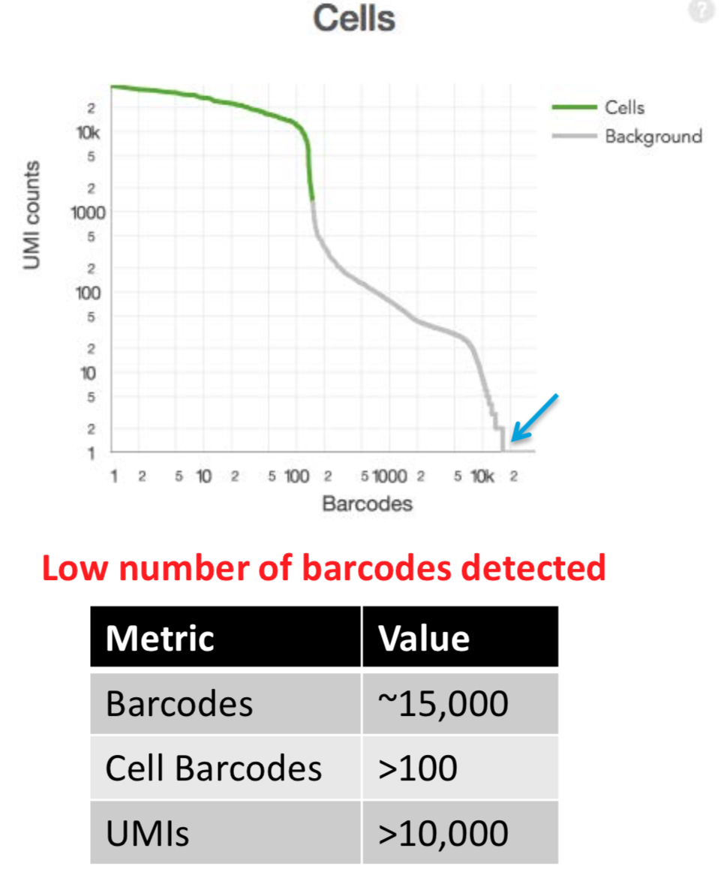
10x Chromium
Gel beads + RT in droplets + template-switch approach
CellRanger QCplots Troubleshooting
Ambient RNA +++
-> cell death
Typical Profile
Lysis / Wetting Failure
Clogs

Slide 18
Template-Switch Based
PCR amplification of “full length” cDNA
T7-based
Linear amplification of cDNA
STRT-seq
SmartSeq
MARS-seq
CEL-seq
CEL-seq2
C1
C1
SmartSeq2
SCRB-seq
MATQ-seq
InDrop
sNuc-Seq
Div-Seq
Drop-Seq
10x chromium
DroNc-Seq
Combinatorial indexing
Nanowells
sci-RNA-seq
SPLiT-seq
STRT-seq-2i
Seq-Well
Microwell-seq

Slide 19
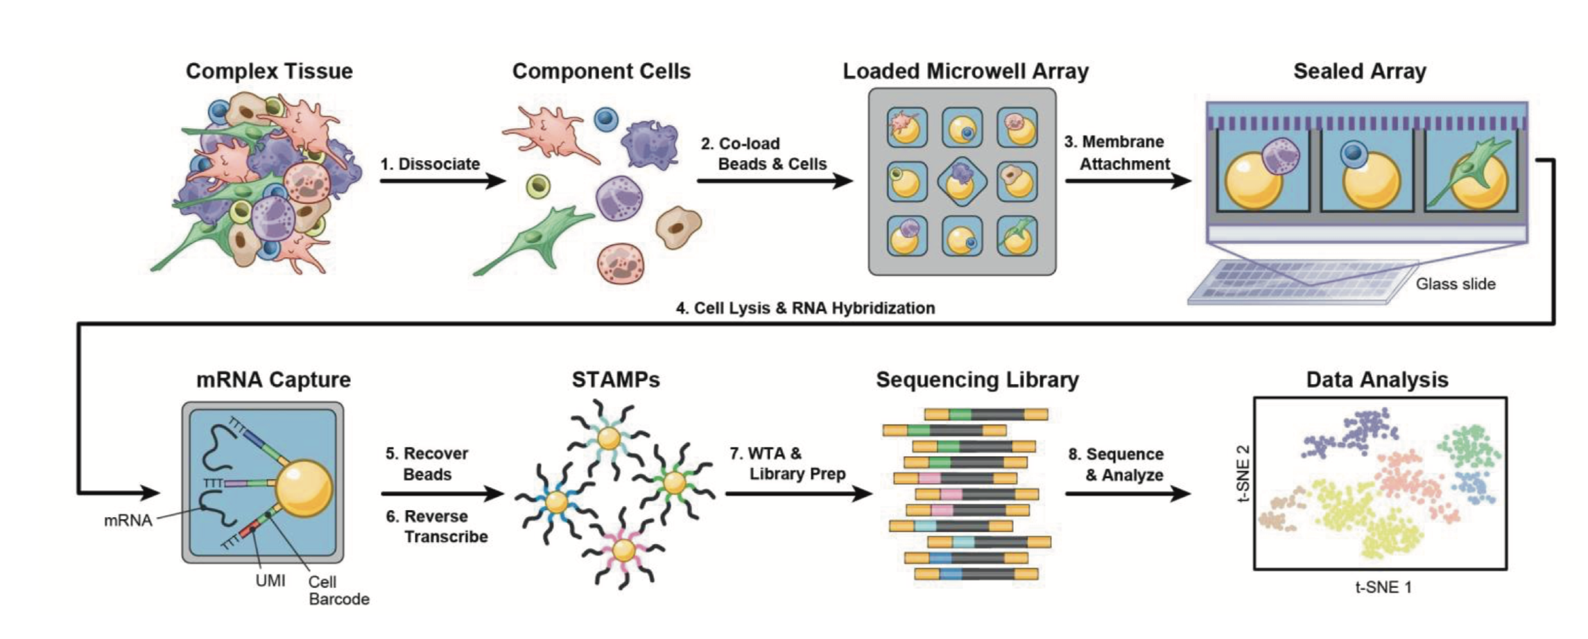
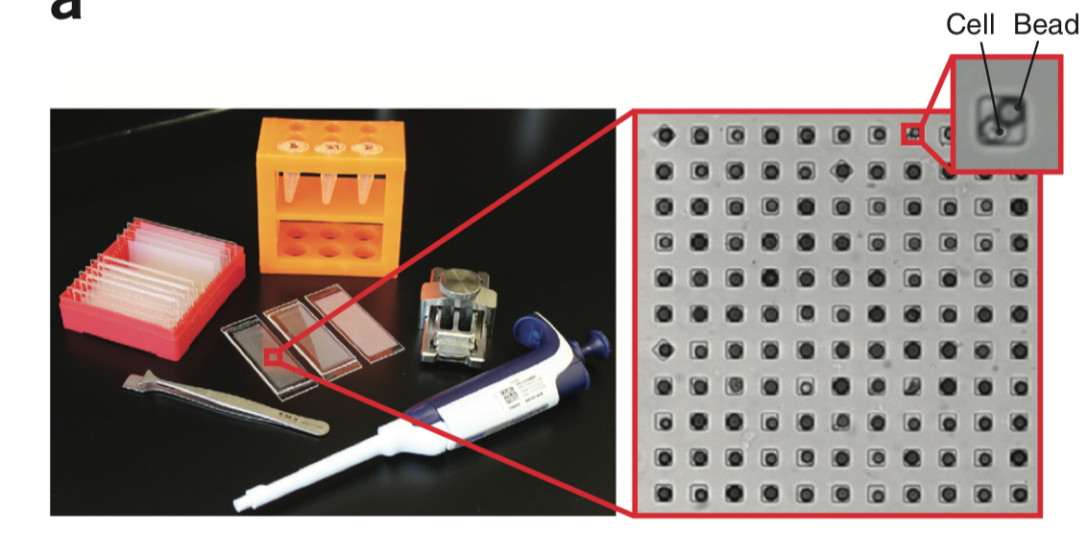
Nanowells: e.g. Seq-well
Gierahn et al. Nature Methods 2017
Han et al. Cell 2018. “Mapping the Mouse Cell Atlas by Microwell-Seq”
-> 400K cells from 51 mouse tissues…

Slide 20
Template-Switch Based
PCR amplification of “full length” cDNA
T7-based
Linear amplification of cDNA
STRT-seq
SmartSeq
MARS-seq
CEL-seq
CEL-seq2
C1
C1
SmartSeq2
SCRB-seq
MATQ-seq
InDrop
sNuc-Seq
Div-Seq
Drop-Seq
10x chromium
DroNc-Seq
Combinatorial indexing
Nanowells
sci-RNA-seq
Seq-Well
SPLiT-seq
STRT-seq-2i

Slide 21
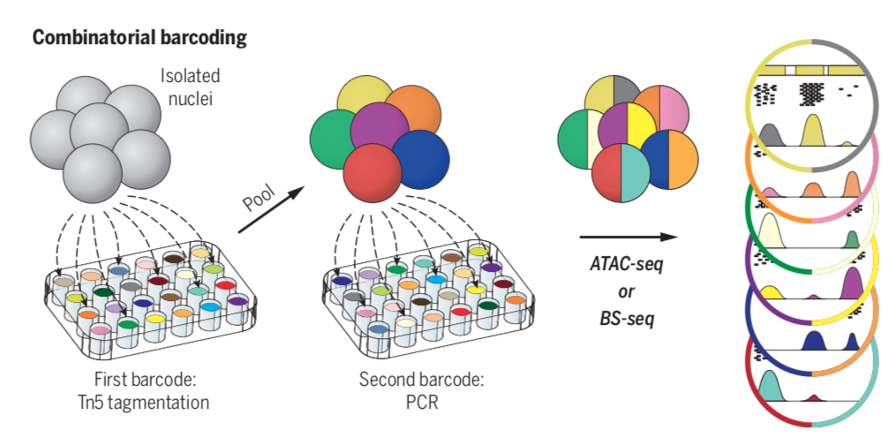
Combinatorial Indexing Approaches
Shendure & Trapnell labs …..
isolated cells
/ nuclei
10s
per well
1000s
per well
first barcode
(in-situ)
second barcode
barcodes combination
gives single cell resolution
Getting large number of cells without single cell compartimentalisation, only basic labware
General CONS: a lot of cells are needed.
doublets = barcodes collision can be an issue (5-10%)

Slide 22
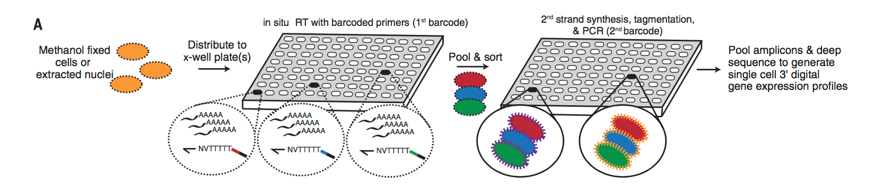
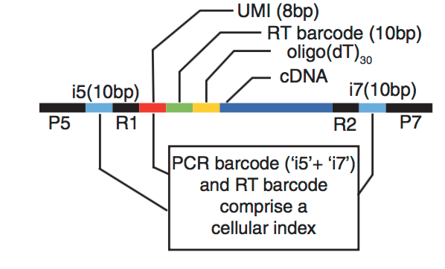
scRNA-seq using combinatorial indexing approaches:
sci-RNA-seq
Cao et al. Science 2017
~4500 genes per mouse cell (3T3) (~similar to 10x)
Cao 2017: can process 10,000s per experiments
Cao 2019: sci-RNAv3: 2M cells in one experiment (3 rounds of barcoding)
Pros: - do not require expensive / complicated microfluidics instruments.
- compatible with cells and nuclei. Need fixation so storage +++
Cons: a lot of cells are required.
SPLiT-seq: Rosenberg et al. Science 2018 (100K cells)

Slide 23
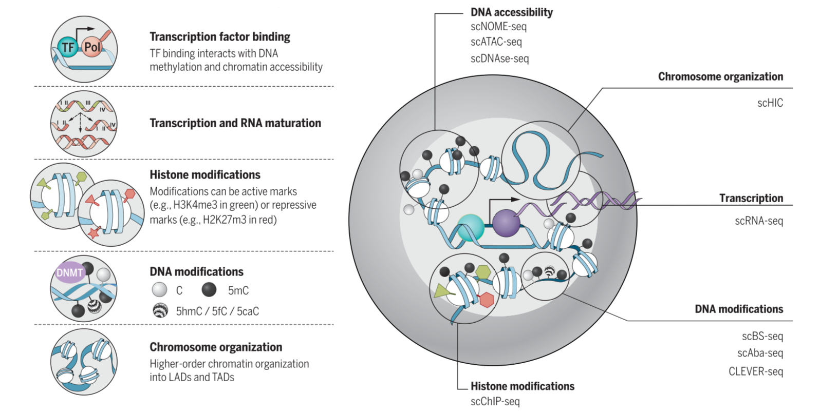
Not only mRNA.
gDNA
Small RNA
ATAC-seq
BS-seq (DNA methylation)
ChIP-seq
scHiC
…
Kelsey et al. Science 2018

Slide 24
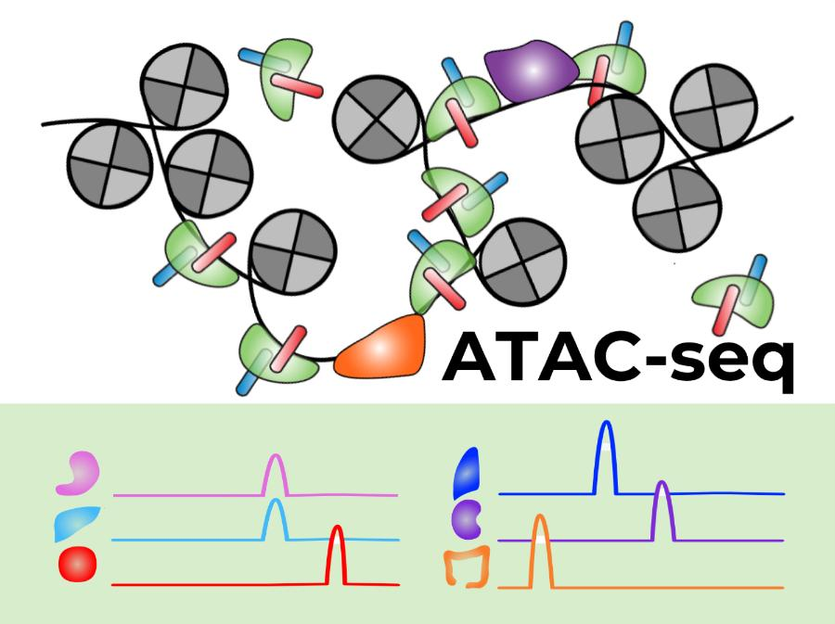
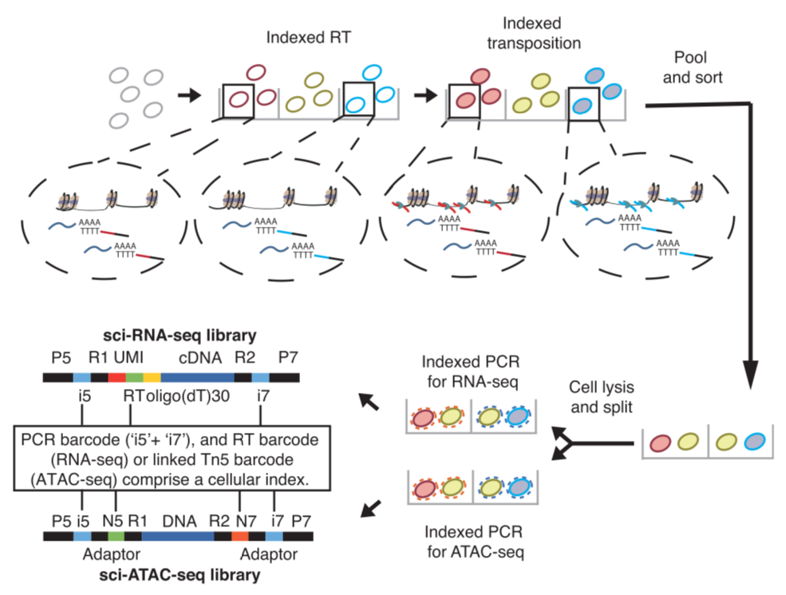
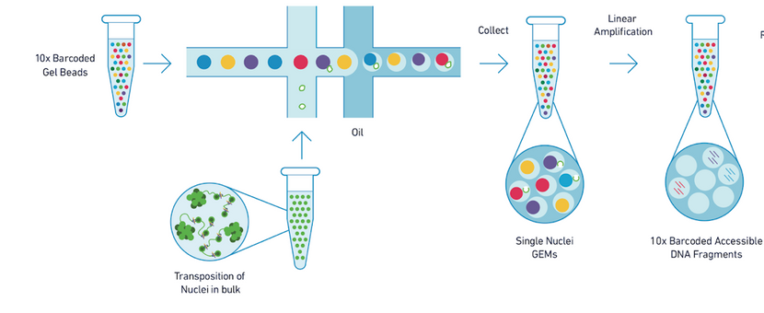
Single Cell Chromatin Accessibility (scATAC-seq)
Tn5
sci-ATAC-seq
10X scATAC-seq
Pool and Split
25-35K unique reads per cell (?)
Cusanovich et al. Science 2015
coverage of 0.3-3% of DHS sites
Cusanovich et al. Cell 2018
100K cells profiled, 10-25K unique reads per cell (40% in bulk ATAC peaks)
CONS: sparse data + high doublets rate (5-10%)

Slide 25
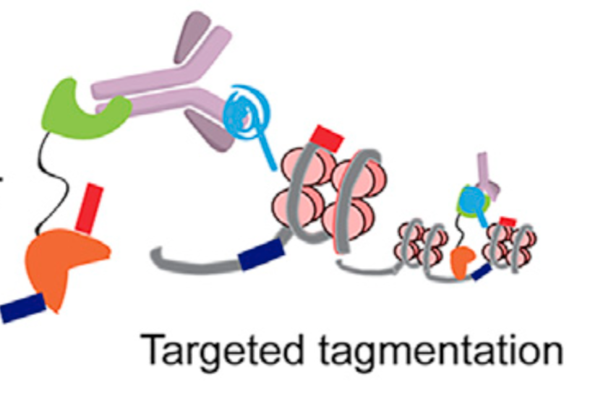
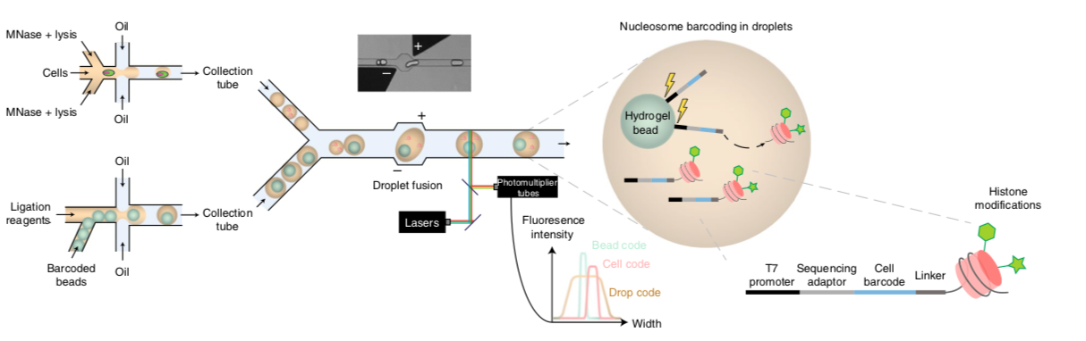
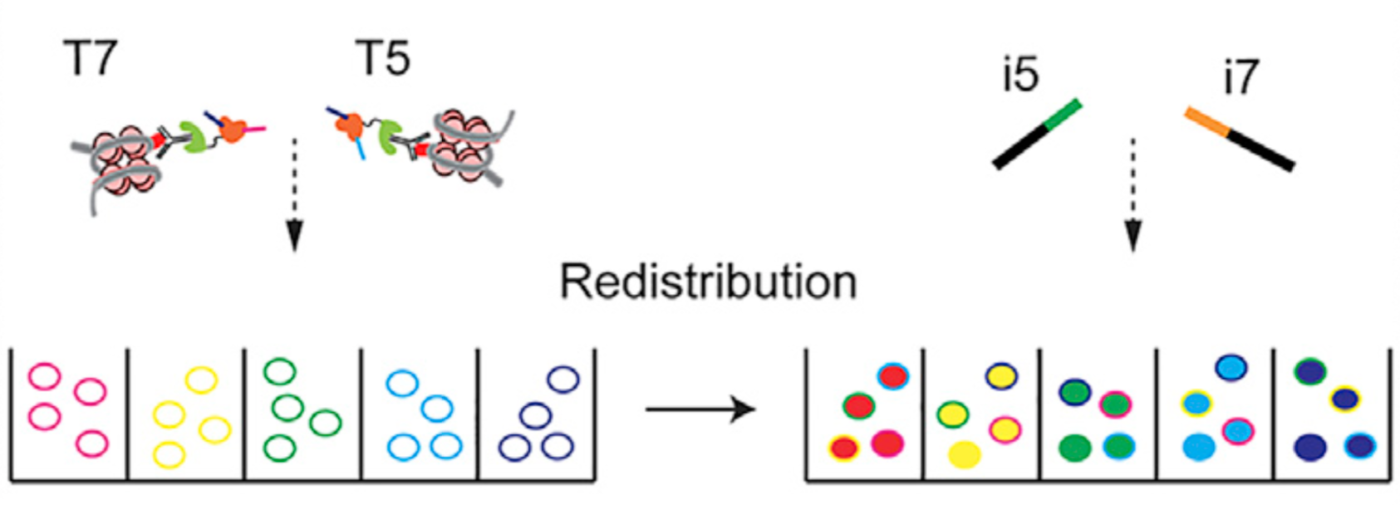
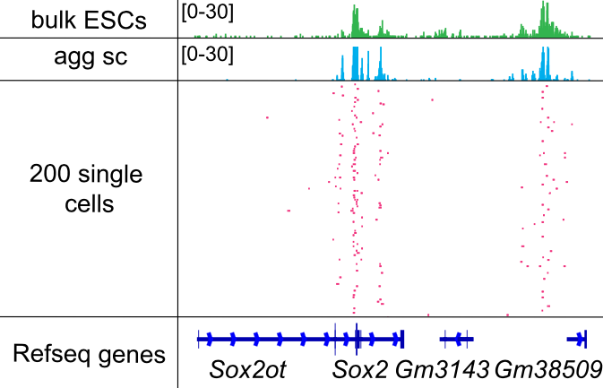
scChIP-seq
CoBATCH
Ab
scChIP-seq
-> custom microfluidics
-> barcoded nucleosomes + “bulk” ChIP
ProtA
Tn5
targeted tagmentation
~10K unique reads per cell (H3K27ac)
Y
10K unique reads per cell / loci (K27me3)
works on single cells and single embryos
Wang et al. Mol Cell 2019
Grosselin, K. et al. Nat Genet 2019

Slide 26
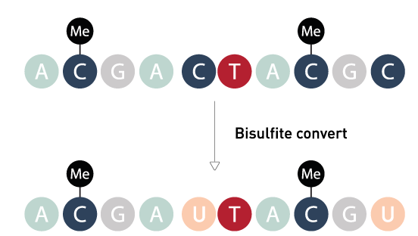
DNA methylation
scBS-seq (PBAT based)
methylated and unmethylated CpGs are ”encoded” in reads

Slide 27
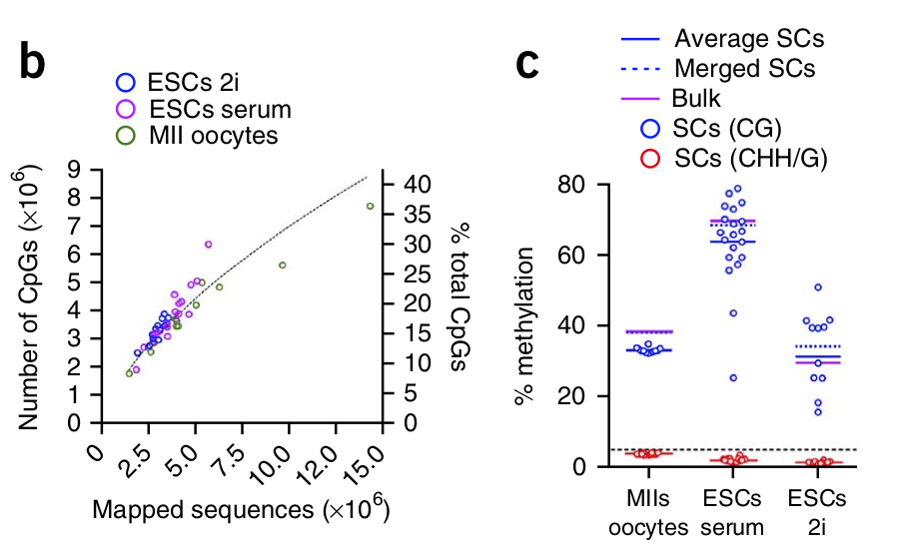
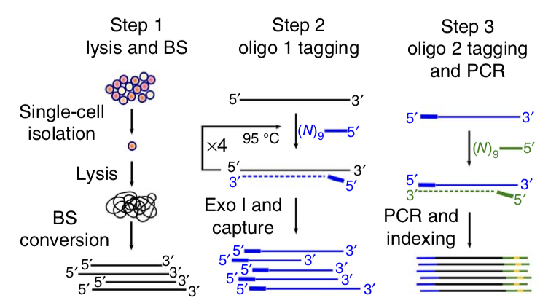
DNA methylation
scBS-seq (PBAT based)
PROS: 15-25% of CpGs covered (up to 40%)
CONS: relative low throughput (1,000s cells)
high cost library prep + sequencing
Smallwood et al. Nat Methods 2014
See also Farlik et al. Cell Reports 2015, Luo et al. Science 2017

Slide 28
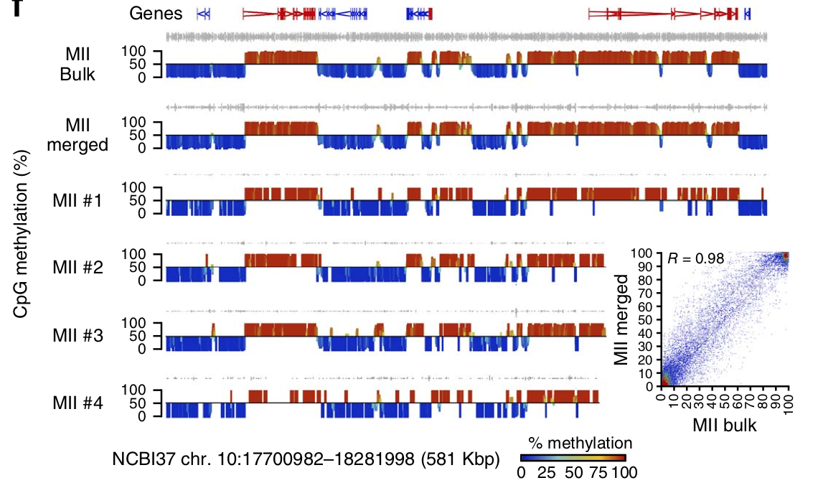
DNA methylation
scBS-seq (PBAT based)
Reconstructing full methylome from very low cell numbers
Smallwood et al. Nat Methods 2014
See also Farlik et al. Cell Reports 2015, Luo et al. Science 2017

Slide 29
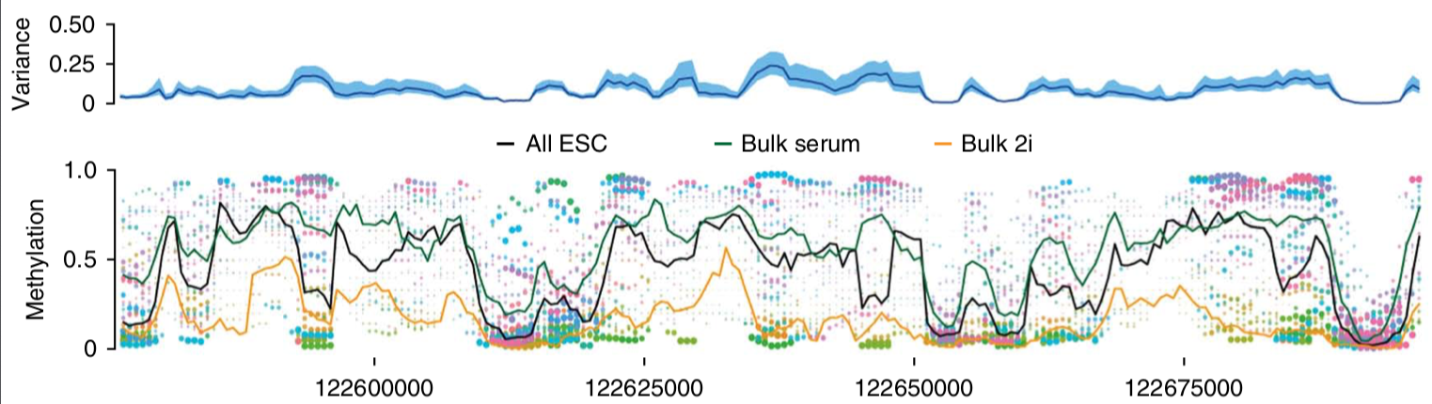
DNA methylation
scBS-seq (PBAT based)
Investigating DNA methylation heterogeneity
Smallwood et al. Nat Methods 2014
See also Farlik et al. Cell Reports 2015, Luo et al. Science 2017

Slide 30
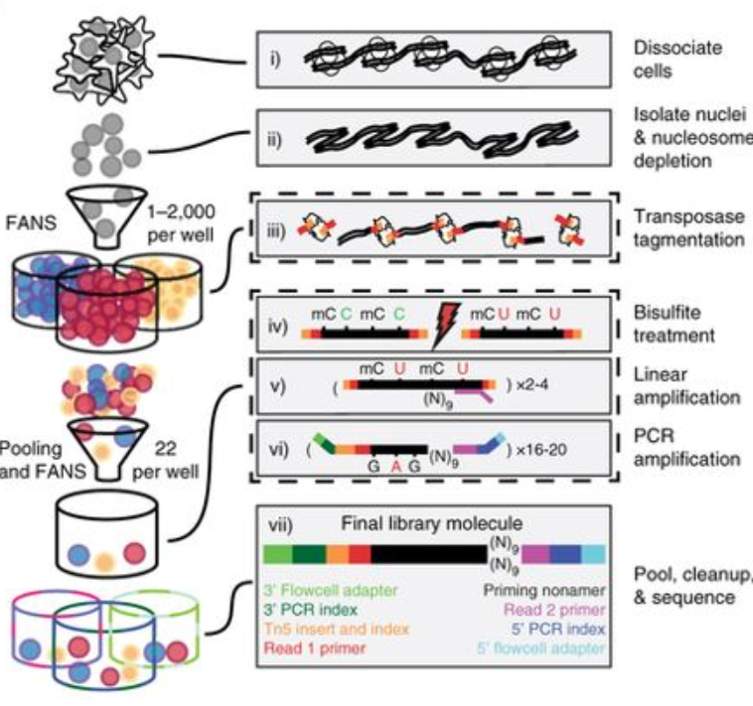
DNA methylation
scBS-seq (PBAT based)
sci-MET
PROs: 20-25% of CpGs covered (up to 40%)
CONs: relative low throughput (1000s cells)
high cost library prep + sequencing
Up to 7% of CpGs (1% median)
average throughput (~500cells)
Mulqueen et al. Nat Biotech 2018
Smallwood et al. Nat Methods 2014
See also Farlik et al. Cell Reports 2015, Luo et al. Science 2017

Slide 31
INTEGRATED MULTI-OMICS:
transcriptome + another layer of information from the same cell

Slide 32
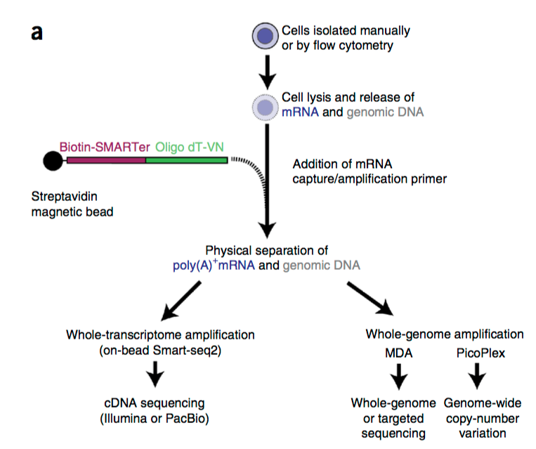
scG&T-seq: Transcriptome + Genome
scM&T-seq: Transcriptome and DNA methylome
gDNA sequencing
scBS-Seq
Pros: Quality is high (5000-6000 genes + 20% of the DNA methylome)
Cons: Relative Low-Throughput + Expensive
scG&T: Macaulay et al. Nat. Methods 2015
scM&T: Angermueller et al. Nat. Methods 2016

Slide 33
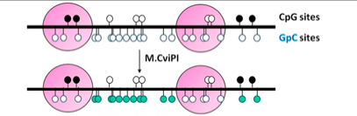
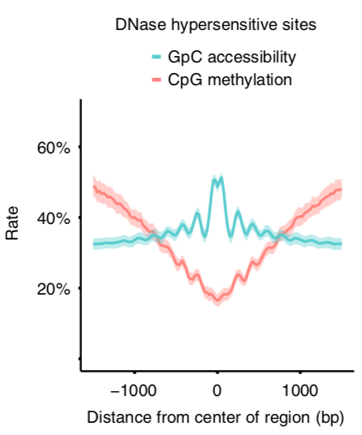
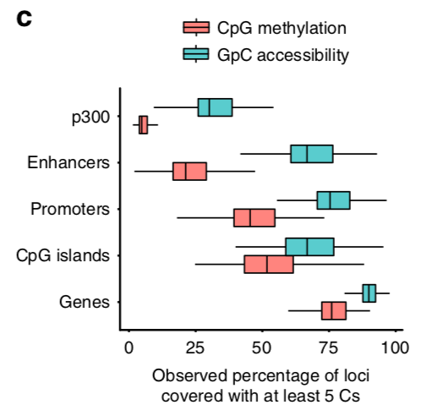
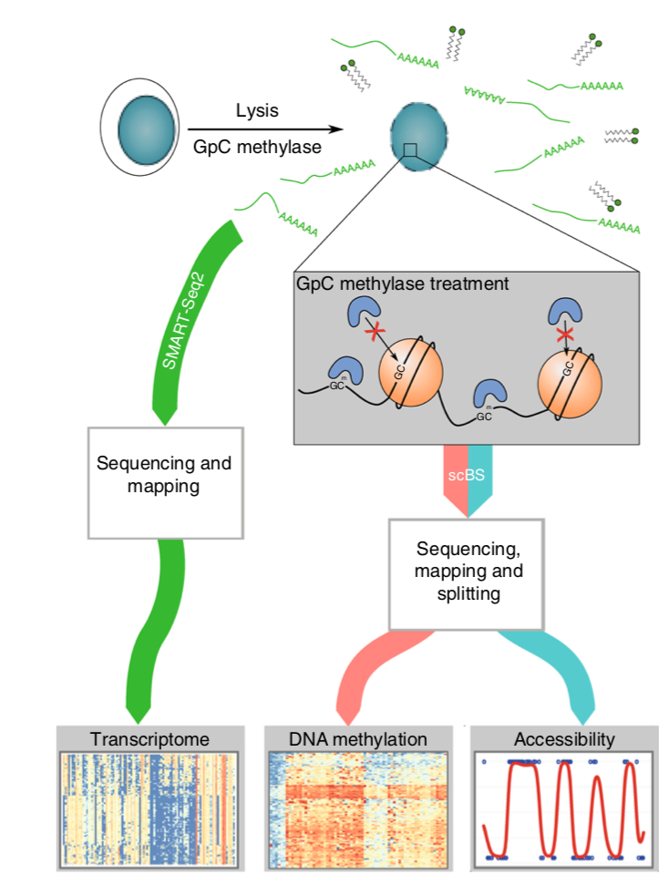
scNMT: transcriptome + DNA methylation + chromatin accessibility
NOME-seq
~75% of promoters, ~60% of enhancers
are captured in a typical cell
Clark et al. Nat Communication 2018

Slide 34
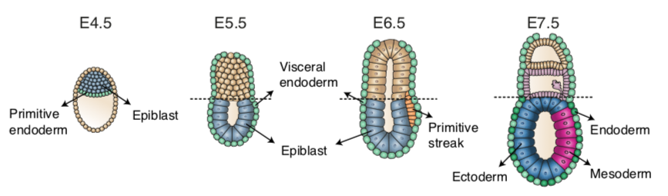
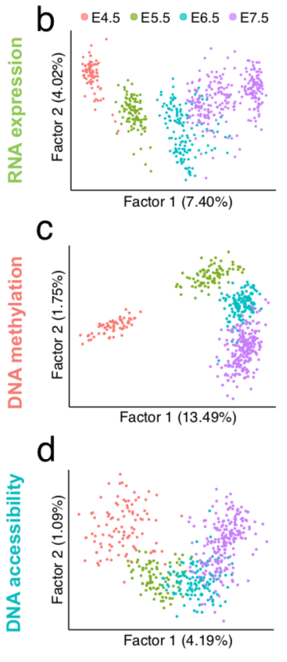
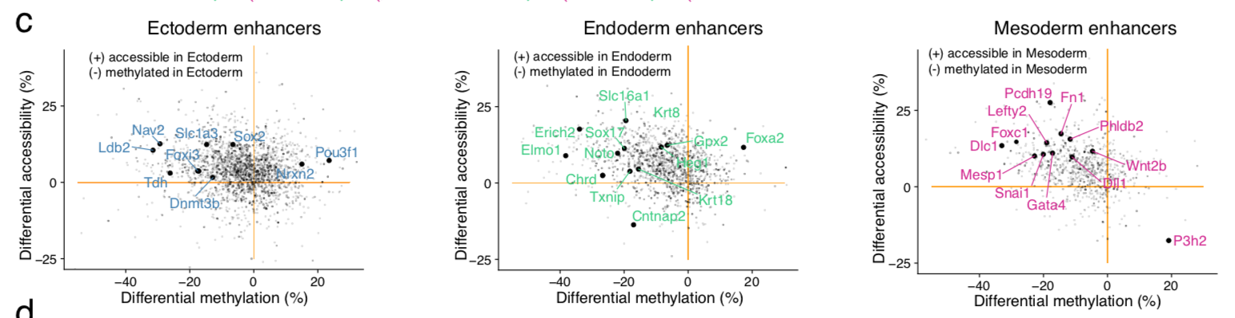
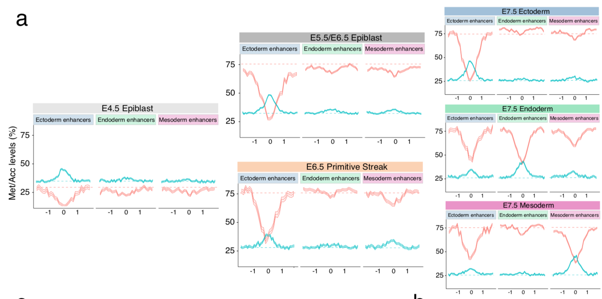
scNMT: transcriptome + DNA methylation + chromatin accessibility
the epigenetic landscape of ectodermal cells is already established in the early epiblast.
regulatory elements associated with each germ layer are either epigenetically primed or epigenetically remodeled prior to overt cell fate decisions during gastrulation.
Argelaguet et al. Nature (in press + BioRXiv)

Slide 35
sci-CAR: Chromatin Accessibility + RNA
Cao et al. Science 2018
See Chen et al. Nat Biotech 2019: SNARE-seq

Slide 36
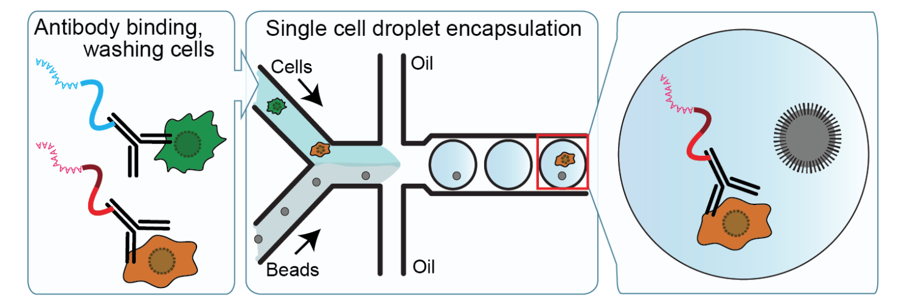
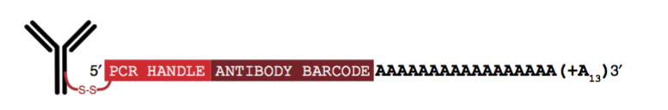
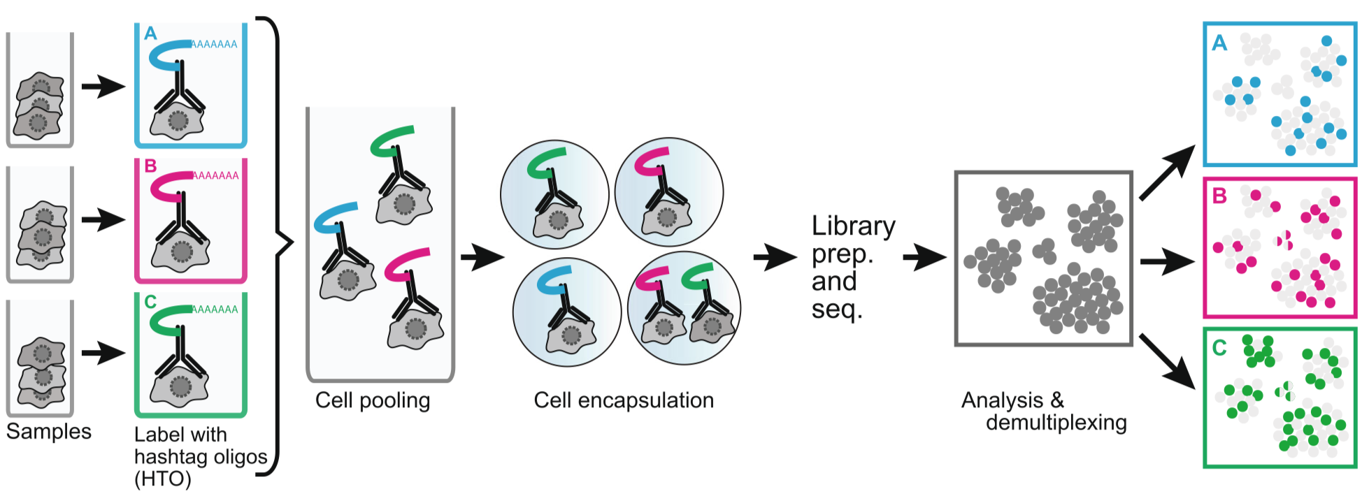
CITE-seq / REAP-seq: cell surface markers + transcriptome
Stoeckius et al. Nat. Methods 2017
Peterson et al. Nat Biotechnology 2017
Cell hashing: increase cell loading + detection of doublets…
Stoeckius et al. Genome Biology 2018

Slide 37
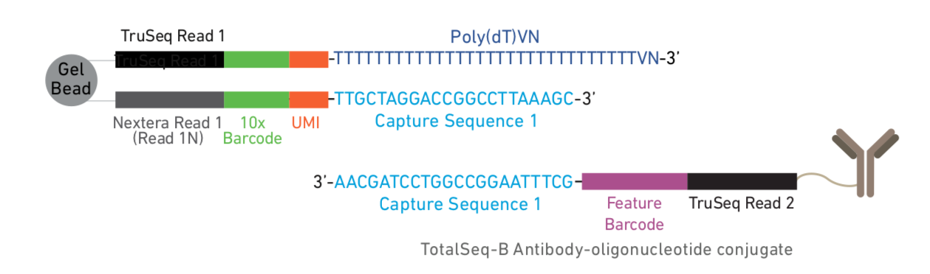
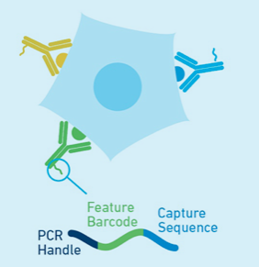
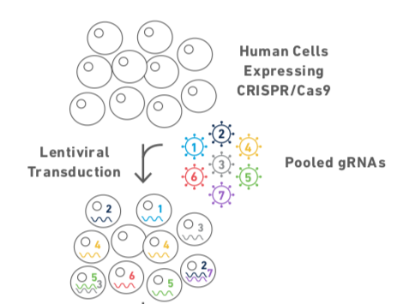
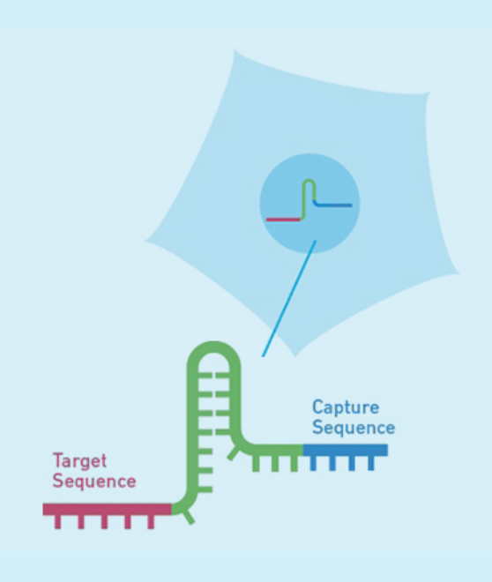
10x ”feature barcoding”
CITE-seq
CRISPR screening (Pertub-seq)
CRISPR mediated perturbations to analyze regulatory gene networks and pathways
Dixit et al. Cell 2016, Adamson et al. Cell 2016

Slide 38
Thanks for listening…...
Sébastien Smallwood – FMI
sebastien.smallwood@fmi.ch

Slide 39
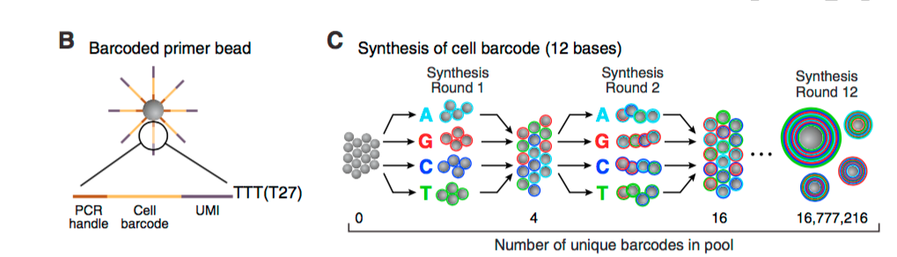
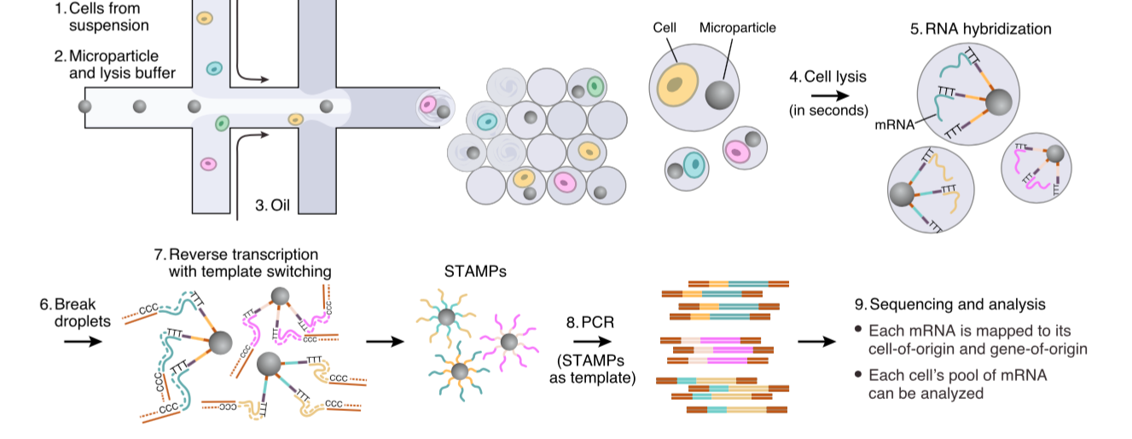
Drop-seq: Template-switch Based
Drop-seq
barcodes
Macosko et al. Cell 2015

Slide 40


InDrop: T7-based
Klein et al. Cell 2015

Slide 41
Drop-seq versus InDrop
Drop-seq:
Pros: Widely adopted as beads barcodes / chips commercially available.
Cons: RT outside droplets - issue with ”ambient” RNA (cells BC with low UMIs)
High variability between set-ups…good and bad datasets out-there...
Capture rate low.
InDrop:
Pros: Quality is better than Drop-seq
Gel beads + RT within droplets (higher sensitivity).
High capture rate.
Cons: Challenging to make gel beads and barcodes (robotics helpful).
Microfluidics chips to be “made” (2 types of chips)
Now InDrop commercial solutions available

